Slide 1
RaDAR
By: - Ken M0KPB
ZS2KPB
VK2KEN
June 2010

Slide 2
Improvise
&
Adapt !!!

Slide 3



RaDAR
This system and the equipment
can also be used in conjunction with HAMNET
Our equivalent of RAYNET

Slide 4


Slide 5
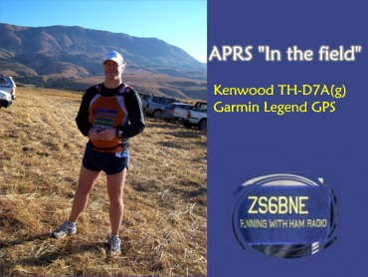
This contest was instigated last year by ZS6BNE Eddie.
Tests were carried out for it’s feasibility and the first Contest
took place this year 3 April 2010. By all accounts it has been
very successful. By all accounts it appears that HAMS always
try to bend the rules But Eddie is quick off the mark and
Ensures that the rules are adhered to!!

Slide 6
Rapid Deployment Amateur Radio
Radio amateurs are getting ready for the First SARL RaDAR Contest on the 3rd of April 2010. The contest rules can be seen here.
The SARL Blue Book

Slide 7
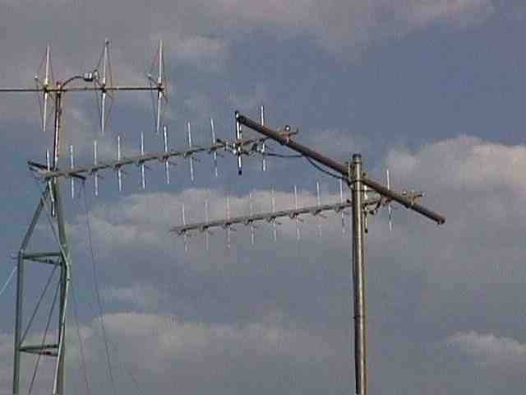
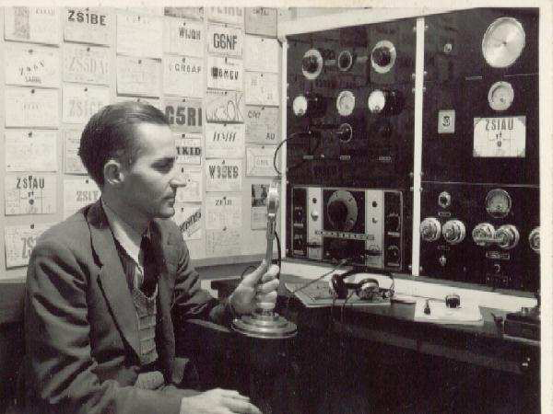
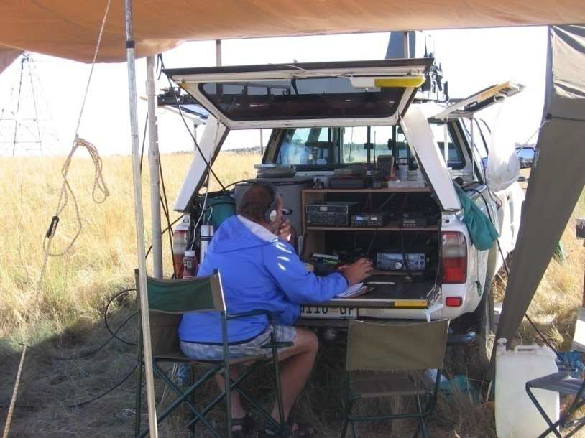
South African Radio League
2010 Contest Manual
“The Blue Book”

Slide 8
Note: This contest is for everyone , at home , in your car , in the field. Any mode , CW , SSB , FM or digital modes. Any band or Satellite. Support your friends in the field , you never know , you may work a really rare grid in the process!
Aim:
An event aimed at promoting the use of Rapid Deployable Amateur Radio stations and antennas preferably without relying on normal mains power (Eskom). All stations including home stations are welcome to participate and to share in the fun.
The points system is so structured to encourage portable operation. Score multipliers are used to reward and favour the portable stations and for stations using temporary antennas and alternative power supply sources.
Date:
First Saturday of April and First Saturday of November

Slide 9
Mode:
Any mode
If the grid locator is not known, then some other information that could describe the location. E.g. Mabula lodge, 40 km west of Warmbaths.
The true RaDAR station must have carried the entire station including antennas for at least 1 km prior to setting up, without relying on existing man made infrastructures i.e. antennas, masts or towers.
For the sake of safety, it will be acceptable to carry / backpack your entire station for a distance of at least 1 km and end up where you started from; your home, camp site, picnic site, motor vehicle or where ever you choose to operate from.
To be considered as a RaDAR station, the entire station; radios, batteries, mast and antennas must be easily portable and hence the need to carry the equipment for at least 1 km.

Slide 10
Suggested operating frequencies!
_Band ___CW ___ Phone ____Notes
160 m _1836 kHz _1845 kHz Class A1, A2 only
_80 m _3560 kHz _3690 kHz
_40 m _7030 kHz _7090 kHz
_30 m 10116 kHz 10130 kHz Class A1 only
_20 m 14080 kHz 14240 kHz Class A1, A2 only
_15 m 21080 kHz 21350 kHz Class A1, A2 only
_10 m 28060 kHz 28360 kHz
160 meters
1807 - PSK31, MT63 and MFSK
1838 - PSK31 and MFSK
80 meters
3580 - PSK31 and PSK63
3582 - MFSK16 and MT63 500Hz Short interleave
3585 - MT63 1000Hz Long
40 meters
7030 - PSK31 - Europe PSK frequency
7035 - PSK31, MT63, digital modes for all DX 7037 - MT63 - Europe MT63
7035 - PSK31
30 meters
10132 through 10139 - PSK31 and other modes
10137 - MT63

Slide 11
20 meters
14064.5 - Clover
14065 - Clover
14070 - Just about everything MixW offers can be found here
14109 - Mostly MT63, some MFSK and occasional Q15X25
14109.5 - Q15X25 - MixW centers at 1375Hz above VFO frequency. I use the settings that Ron KA2HZO have documented on his website.
14111 - same as 14109.5
14113 - same as 14109.5
14115 - same as 14109.5
17 meters
18100 - PSK, MT63 and other modes
15 meters
21109 - PSK, MT63 and other modes - MT63 on sked
21130 - PSK, MT63 and other modes - EU
21070 - PSK, MT63 and other modes
12 meters
24920 - PSK, MT63 and other modes
24930 - MT63 in Europe, although this is the upper edge of the CW/data subband in the US and is the 12m NCDXF beacon frequency
10 meters
28120 - PSK, MT63 and other modes
28130 - PSK, MT63 and other modes

Slide 12
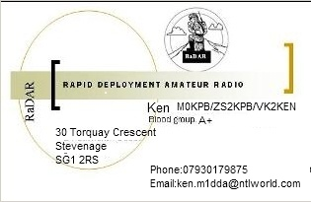
Safety First: - Always carry some form of ID
with contact Address, Numbers & Blood group.
& if out alone in the BUNDU a WEAPON!!!!!!!!
OF some sort!!

Slide 13
Main Objectives
1. Carry everything that will be used to
deploy for 1 Km?
2. Battery power ONLY
3. Operate for 6 hours = 4 hours daylight and 2 hours in
darkness, contest commences at 1400 SAST
(SOUTH AFRICAN STANDARD TIME = 1 hour ahead of BST)
4. Log entry will be Call Sign-Name-QTH-Grid Locator
5. x1 (one) point per contact.
x1 for all home location using normal antennas & mains power.
x2 for nor home stations not relying on normal antennas and power.
x3 for portable stations not relying on mains power. To include MOBILE.
x4 for true RaDAR portable operations .
x5 for true RaDAR portable operations as above and using QRP max output 5 watts PEP.
BONUS POINTS
x5 for satellite or any digital mode involving a computer QSO.

Slide 14
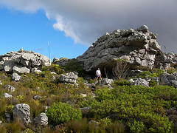
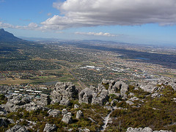
Pictures of deployments this year
Allen ZR1AAH and Dennis ZS1TC
Steenberg Ridge, directly above the Silvermine Naval Base,

Slide 15
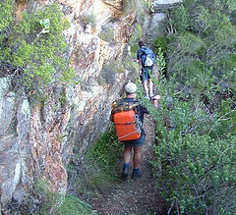
ZS1ZL and ZR1AAH heading into Slangolie Ravine, Table Mountain

Slide 16
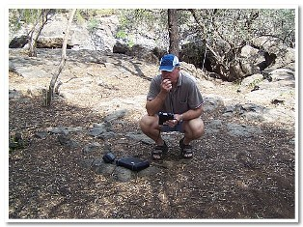
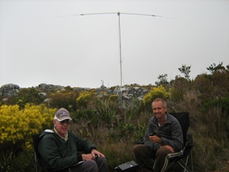
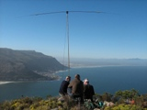
Eddie ZS6BNE
Howard Green ZS1JHG on the left, Deon ZS1AFU on the right.
Sam ZS1SAM, Deon ZS1AFU,
Howard ZS1JHG

Slide 17


Pierre ZS6BQS , Now ZS6BB
Lichtenburg game breeding centre

Slide 18
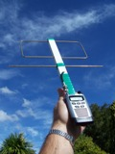
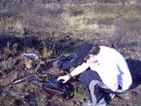
Alinco DJ-C7 connected to a TPM II Loop antenna. Ideal for use with FM Low Earth Orbit Satellites while in the field
Rory ZR6RBJ

Slide 19
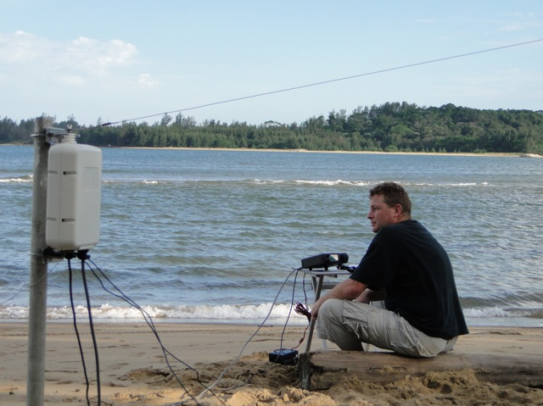
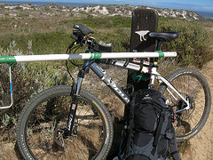
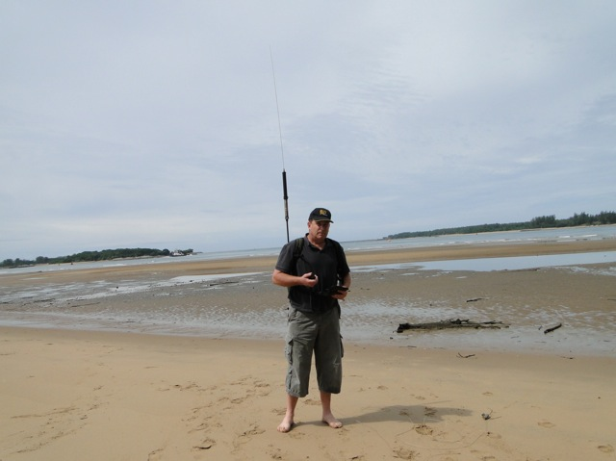
ZS5J John
ZR1AH Allen

Slide 20
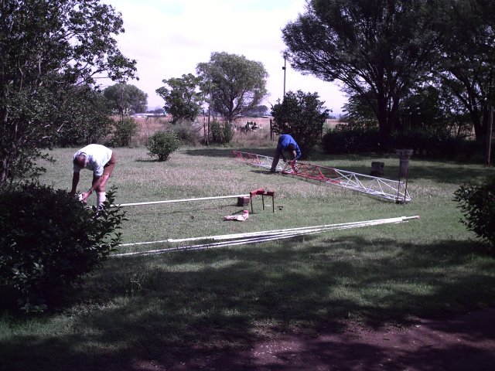
ZS6MEG MIKE
Famous for his
Tower building
This is the lightweight 12 meter field mast that I built for RaDAR (Rapid Deployment Amateur Radio) contest.

Slide 21
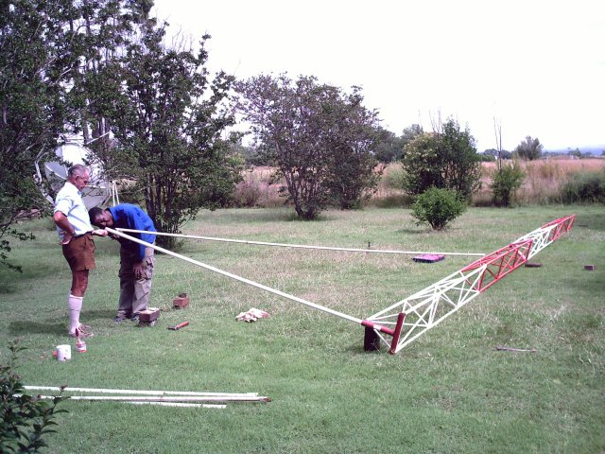
The total weight is about 50KG and it can be disassembled into easily manageable sections for easy handling and assembly.

Slide 22
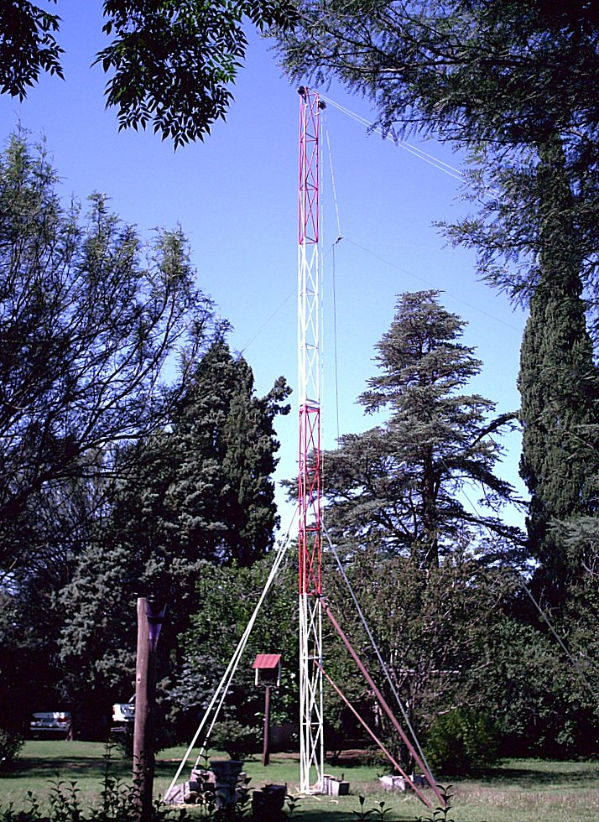
ITS UP!!

Slide 23


Slide 24
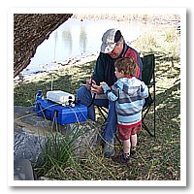
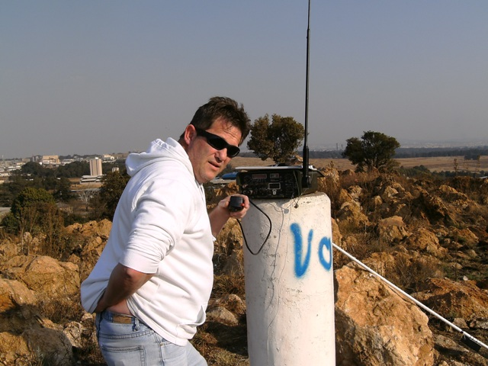
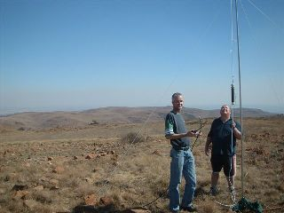
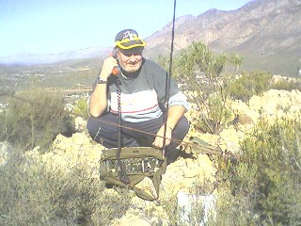
Kevin ZS6KMD
ZS6BNE
ZU6ET & ZU6TAN
ZS1HR Hennie

Slide 25
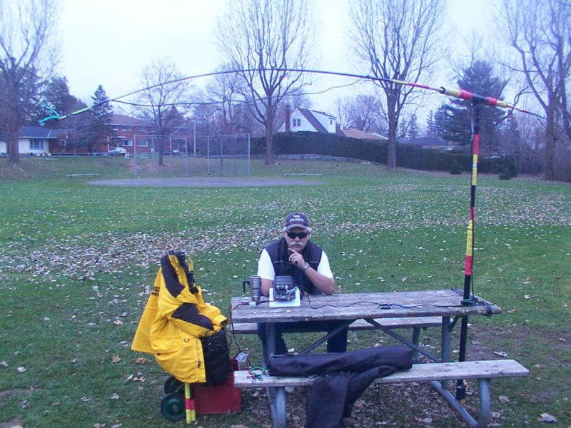
VA3RCS
Bob Sharp VA3QV
Even Canada is now showing an interest in this contest

Slide 26
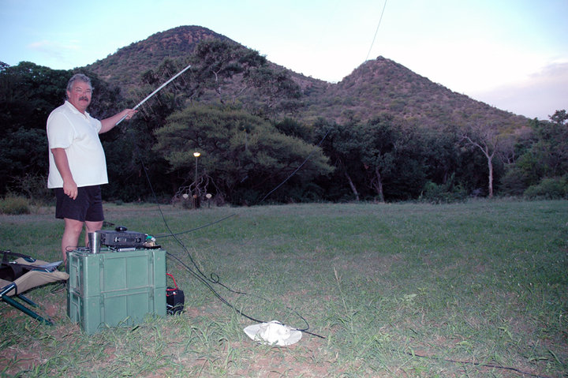

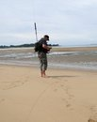

Slide 27




Slide 28
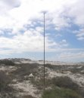



Slide 29
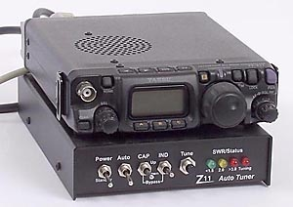
Most favoured RIG FT 817 + LDG

Slide 30
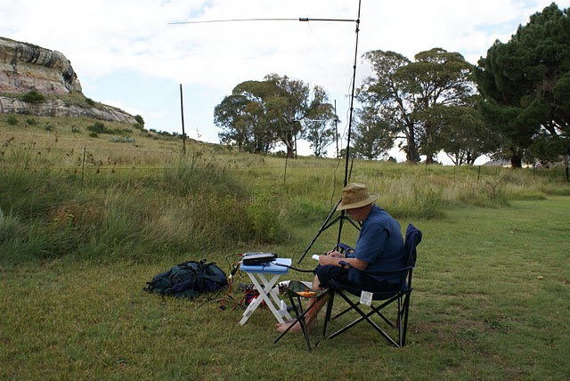
ZS5C/4 Shaun operating QRP

Slide 31
The results this year 2010 April were
That over 100 individuals took up the
challenge! & It was considered a
complete success .
The next RaDAR takes place in
November 2010.

Slide 32
The End
Any questions?
I will try to answer them??

